Slide 1
Unit-4
GRAPH

Slide 2
Contents…
Representation of graph
Graph Traversals –
  Depth-first and breadth-first traversal
Applications of graphs
Topological sort –
  Shortest path algorithms-Dijkstra’s algorithm
Minimum spanning tree –
  Prim's algorithm
  Kruskal's algorithm

Slide 3
Graph Data Structure
A graph is a non-linear data structure.
A graph is a pictorial representation of a set of objects where some pairs of objects are connected by links.
A Graph consists of set of vertices (V) and set of edges(E).
  The vertices are referred as nodes.
  The edges are lines or arcs that connect any two nodes in the graph.
A graph G can be defined as an ordered set G(V, E)
where V(G) represents the set of vertices and
E(G) represents the set of edges used to connect these vertices.
A graph can be seen as a cyclic tree.

Slide 4
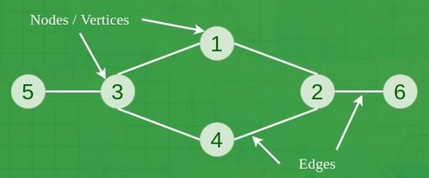
Terminologies in Graph
A graph G(V,E) is a data structure that consists of :
1. A finite set of vertices (V) also called as nodes.
2. A finite set of ordered pair of the form (u, v) called as edge (E).
Vertices:
Fundamental units of the graph.
Also known as vertex or nodes.
Every node/vertex can be labeled
or unlabelled.
Edges:
Edges are drawn or used to connect two nodes of the graph called as Arcs.
It can be ordered pair (u, v) of nodes in a directed graph.
Edges can connect any two nodes in any possible way.
Every edge can be labeled/unlabelled.

Slide 5
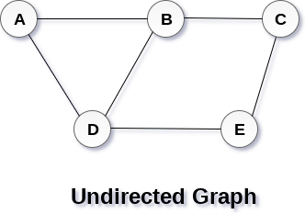
Terminologies in Graph
A graph can be directed or undirected.
Undirected Graph
  In undirected graph, edges are not associated with directions with them.
  The edges are not attached with any of the directions.
  If an edge exists between vertex A and B then vertices can be traversed from B to A as well as A to B.
A Graph G(V, E) with 5 vertices
(A, B, C, D, E) and
six edges ((A,B), (B,C), (C,E), (E,D), (D,B), (D,A))

Slide 6
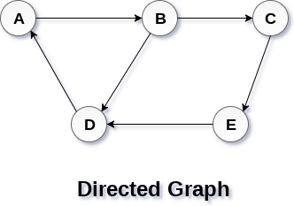
Directed Graph
  In a directed graph, edges form an ordered pair (u, v).
  Edges represent a specific path from
  some vertex A to another vertex B.
  Node A is called initial node while
  node B is called terminal node.
Path
    A path is sequence of nodes that are followed in order to reach some terminal node V from the initial node U.
Closed Path
    If initial node is same as terminal node is called as closed path
    A path will be closed path if V₀=V_{N}.

Slide 7
Cycle
  A cycle is a path which has no repeated edges or vertices except the first and last vertices.
Connected Graph
  A connected graph is the one in which some path exists between every two vertices (u, v) in V.
  There are no isolated nodes in connected graph.
Complete Graph
  A complete graph is the one in which every node is connected with all other nodes.
  A complete graph contain n(n-1)/2 edges where n is the number of nodes in the graph.

Slide 8
Weighted Graph
  Each edge is assigned with some data such as length or weight.
  The weight of an edge e can be given as w(e) which must be a positive (+) value indicating the cost of traversing the edge.
Digraph
  A digraph is a directed graph in which each edge of the graph is associated with some direction and the traversing can be done only in the specified direction.
Adjacent Nodes
  If two nodes u and v are connected via an edge e, then the nodes u and v are called as neighbours or adjacent nodes.
Degree of the Node
  A degree of a node is the number of edges that are connected with that node.
  A node with degree 0 is called as isolated node.

Slide 9
Graph Representation
A graph is a data structure that consist a sets of vertices/nodes and edges.
There are two ways to store Graphs into the computer's memory:
  Sequential representation (Adjacency matrix representation)
  Linked list representation (Adjacency list representation)
Sequential Representation
  An adjacency matrix is used to store the graph.
  Adjacency matrix is used to represent mapping between vertices and edges of the graph.
  Adjacency matrix to represent the undirected graph, directed graph, weighted directed graph, and weighted undirected graph.
  If adj[i][j] = w, there is an edge exists from vertex i to vertex j with weight w.

Slide 10
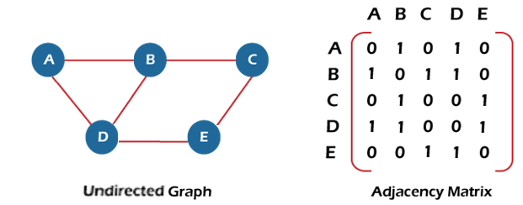
Adjacency matrix for a undirected graph
Undirected Graph G consists of n vertices.
  Adjacency matrix for graph is n x n
  The matrix A = [aij] can be defined as -
  a_{ij} = 1 {if there is a path exists from V_{i} to V_{j}}
  a_{ij} = 0 {Otherwise}
In an adjacency matrix,
  0 represents no edge
  exists between the nodes
  1 represents path/edge
  between two edges.

Slide 11
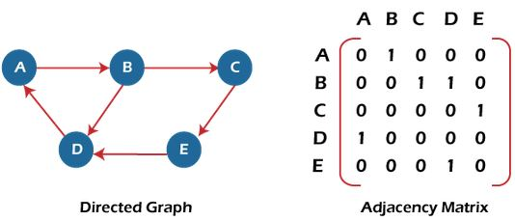
Adjacency matrix for a directed graph
In a directed graph, edges represent a specific path from one vertex to another vertex.
In an adjacency matrix,
  0 represents no directed edge from one node to another.
  1 represents directed edge from one node to another.

Slide 12
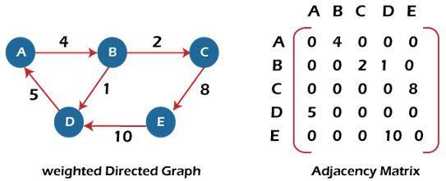
Adjacency matrix for a weighted directed graph
  If existence of a path then instead of '1’, use the weight associated with edge.
  The weights on edges will be represented as entries of adjacency matrix.
  In adjacency matrix, add entry as weights on the edges otherwise 0.

Slide 13
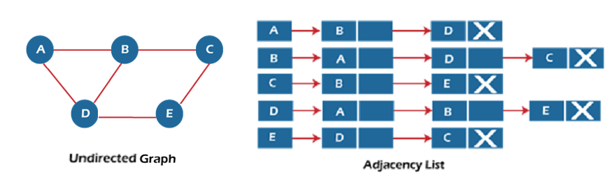
Linked list Representation
There is a use of an adjacency list to store the graph.
An adjacency list is used in the linked representation to store the Graph in the computer's memory.
Adjacency list representation of an undirected graph

Slide 14
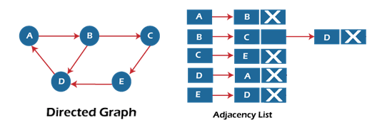
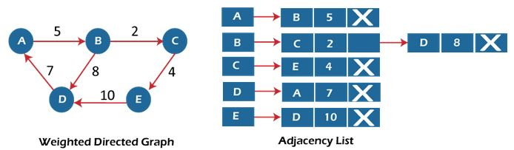
Adjacency list representation of an directed graph
Adjacency list representation of an Weighted directed graph

Slide 15
Graph Traversal
Graph traversal is a technique to visit the each nodes of a graph G.
It is also use to calculate the order of vertices in traverse process.
We visit all the nodes starting from one node which is connected to each other without going into loop.
Two graph traversal techniques
  Depth-first search (DFS)
  Breadth-first search (BFS)

Slide 16
Depth-first Search (DFS) Traversal
The depth-first search algorithm starts with initial node of graph G and goes deeper until we find the goal node or node with no children.
DFS is graph traversal algorithms that use Stack data structure.
In DFS Traversal go as deep as possible of the graph.
Backtrack once reached a vertex that has all its adjacent vertices already visited.
DFS algorithm traverses a graph in a depthward motion.
DFS uses a stack data structure to remember to get the next vertex to start a search when a dead end occurs.

Slide 17
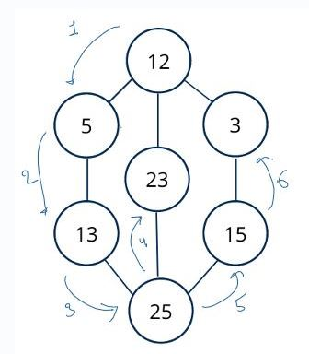
Example of DFS Traversal
Traverse node from 12 to 5 to 13 to 25 to 23 and then 15 to 3.

Slide 18
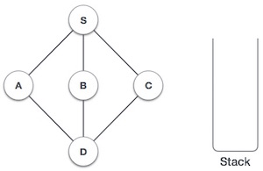
The steps to implement the DFS traversal –
1. First, create a stack with total number of vertices in the graph.
2. Now, choose any vertex as starting point of traversal, and push that vertex into stack.
3. After that, push a non-visited vertex (adjacent to the vertex on top of stack) to the top of the stack.
4. Now, repeat steps 3 and 4 until no vertices
  are left to visit from the vertex on stack's top.
  5. If no vertex is left, go back and pop a vertex
  from the stack.
  6. Repeat steps 2, 3, and 4 until the stack is empty.

Slide 19
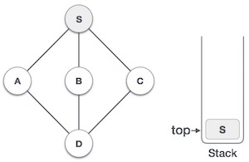
Example
Initialize the stack.
Mark S as visited and put it onto the stack.
Explore any unvisited adjacent node from S.
We have three nodes and we can pick any of them.

Slide 20
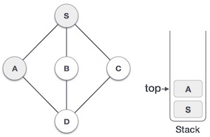
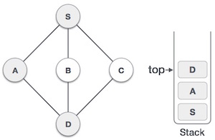
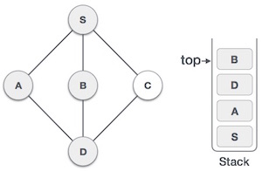
Mark A as visited and put it onto the stack.
Explore any unvisited adjacent node from A.
Both S and D are adjacent to A but concern for unvisited nodes only.
Visit D and mark it as visited and put onto the stack.
Explore any unvisited adjacent node from D.
B and C nodes are adjacent to D which are unvisited. Choose any one.
We choose B, mark it as visited and put onto the stack.
B does not have any unvisited adjacent node.
So, we pop B from the stack.

Slide 21
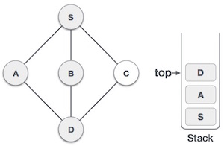
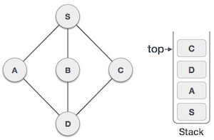
We check the stack top for return to the previous node and check if it has any unvisited nodes.
We find D to be on the top of the stack.
Only unvisited adjacent node is from D
So we visit C, mark it as visited and put it onto the stack.
C does not have any unvisited adjacent node, so we keep popping stack until stack becomes empty.
In this case, there's none and we keep popping until the stack is empty.
DFS traversal is- S A D B C

Slide 22
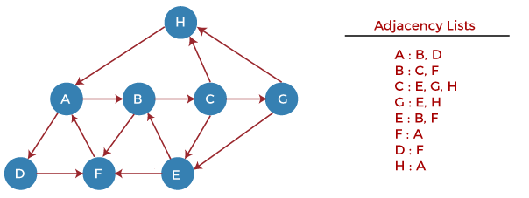
Example- DFS Traversal

Slide 23
Step 1 - First, push H onto the stack. STACK: H
Step 2 – POP top element from the stack, i.e., H, and print it
Now, PUSH all neighbors of H onto the stack. STACK: A
Step 3 – POP top element from the stack, i.e., A, and print it.
Now, PUSH all neighbors of A onto the stack. STACK: B, D
Step 4 – POP top element from the stack, i.e., D, and print it.
Now, PUSH all neighbors of D onto the stack. STACK: B, F
Step 5 – POP top element from the stack, i.e., F, and print it.
Now, PUSH all neighbors of F onto the stack. STACK: B

Slide 24
Step 6 – POP top element from the stack, i.e., B, and print it.
Now, PUSH all neighbors of B onto the stack. STACK: C
Step 7 – POP top element from the stack, i.e., C, and print it.
Now, PUSH all neighbors of C onto the stack. STACK: E, G
Step 8 – POP top element from the stack, i.e., G and
PUSH all the neighbors of G onto the stack. STACK: E
Step 9 - POP the top element from the stack, i.e., E and
PUSH all neighbors of E onto the stack. STACK:
Now, all graph nodes have been traversed, and the stack is empty.
DFS traversal is- H A D F B C G E

Slide 25
Breadth-first search (BFS) Traversal
Breadth First Search (BFS) traversal is used to visit all nodes of a given graph.
In this traversal one node is selected and then all of adjacent nodes are visited one by one.
BFS traversal starts traversing the graph from root node and explores all neighboring nodes.
Then, it selects the nearest node and explores all unexplored nodes.
In BFS for traversal, any node in the graph is considered as root node.
BFS puts every vertex of graph into two categories - visited and non-visited.
It selects a single node in a graph and, after that, visits all nodes adjacent to the selected node.

Slide 26
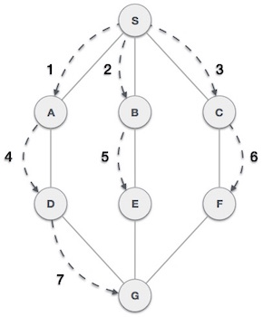
Breadth-first search (BFS) Traversal
BFS traverses a graph in a breadthward motion
BFS graph traversal techniques use a queue data structure to store nodes for further processing.
It uses a queue to remember to get
the next vertex to start a search,
when a dead end occurs.
The size of queue is same as
maximum total number
of vertices in the graph.

Slide 27
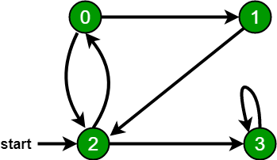
Steps to implement BFS traversal
Declare a queue and insert the starting vertex.
Initialize a visited array and mark the starting vertex as visited.
Visit the adjacent unvisited vertex. Mark it as visited.
Display it. Insert it in a queue.
If no adjacent vertex is found, remove the first vertex from the queue.
Repeat above 2 rules until the queue is empty.
  BFS traversals for graph :
  2, 3, 0, 1
  2, 0, 3, 1

Slide 28
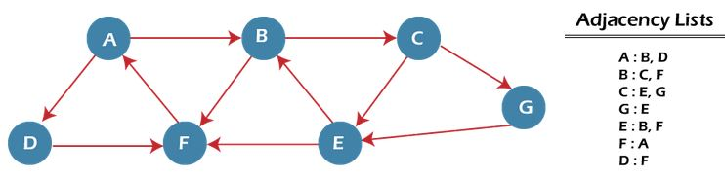
Example- BSF Traversal
BSF uses two queues, namely QUEUE1 and QUEUE2.
QUEUE1 holds all the nodes that are to be processed, while
QUEUE2 holds all the nodes that are processed and deleted from QUEUE1.
Traversal of the graph starting from Node A.

Slide 29
Step 1 - First, add A to queue1 and NULL to queue2.
QUEUE1 = {A} QUEUE2 = {NULL}
Step 2 - Now, delete node A from queue1 and add it into queue2.
Insert all neighbors of node A to queue1.
QUEUE1 = {B, D} QUEUE2 = {A}
Step 3 - Now, delete node B from queue1 and add it into queue2.
Insert all neighbors of node B to queue1.
QUEUE1 = {D, C, F} QUEUE2 = {A, B}
Step 4 - Now, delete node D from queue1 and add it into queue2.
Insert all neighbors of node D to queue1.
The only neighbor of Node D is F since it is already inserted
QUEUE1 = {C, F} QUEUE2 = {A, B, D}

Slide 30
Step 5 - Delete node C from queue1 and add it into queue2.
Insert all neighbors of node C to queue1.
QUEUE1 = {F, E, G} QUEUE2 = {A, B, D, C}
Step 5 - Delete node F from queue1 and add it into queue2.
Insert all neighbors of node F to queue1.
Since all the neighbors of node F are already present in queue.
QUEUE1 = {E, G} QUEUE2 = {A, B, D, C, F}
Step 6 - Delete node E from queue1.
Since all of its neighbors have already been added.
Now, all nodes are visited, and target node E is encountered into queue2.
QUEUE1 = {G} QUEUE2 = {A, B, D, C, F, E}
BFS traversal is- A B D C F E G

Slide 31
Shortest path algorithms-Dijkstra’s algorithm
Dijkstra algorithm is a single-source shortest path algorithm.
Dijkstra algorithm is used find the shortest paths from source to all vertices in the given graph. So it is called as Shortest path algorithm.
Single-source means only one source is given, and to find the shortest path from source to all the nodes.
To find the shortest path, Dijkstra uses weighted graph.
Weighted Graph
  Each edge is assigned with some data such as length or weight.
  The weight of an edge e can be given as w(e) which must be a positive (+) value indicating the cost of traversing the edge.

Slide 32
Shortest path algorithms-Dijkstra’s algorithm
Steps
  Dijkstra's Algorithm starts at node which is source node
  It analyzes the graph to find shortest path between that node and all other nodes in the graph.
  The algorithm keeps track of the currently known shortest distance between nodes and it updates these values if it finds a shorter path.
  Once algorithm has found the shortest path between source node and another node, that node is marked as "visited" and added to the path.
  The process continues until all the nodes in the graph have been added to the path.

Slide 33
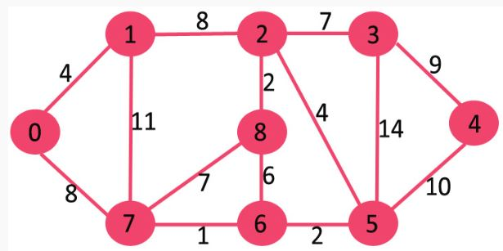
Example:
Source = 0, for given graph.
Find the shortest path from node 0 to all other nodes in graph.

Slide 34
The shortest path from node 0 to all other nodes in graph
The distance from node 0 to node 1 = 4 0->1
The minimum distance from 0 to 2 = 12 0->1->2
The minimum distance from 0 to 3 = 19 0->1->2->3
The minimum distance from 0 to 4 = 21 0->7->6->5->4
The minimum distance from 0 to 5 = 11 0->7->6->5
The minimum distance from 0 to 6 = 9 0->7->6
The minimum distance from 0 to 7 = 8 0->7
The minimum distance from 0 to 8 = 14 0->1->2->8

Slide 35
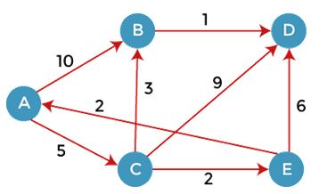
Example:
Source = A, for given graph.
Find the shortest path from node A to all other nodes in graph.

Slide 36
The shortest path from node A to all other nodes in graph
The distance from node A to node B = 8 A->C->B
The minimum distance from A to C = 5 A->C
The minimum distance from A to D = 9 A->C->B->D
The minimum distance from A to E = 7 A->C->E

Slide 37
Minimum spanning tree
Spanning tree
A spanning tree is a subgraph of an undirected connected graph.
It includes all the vertices along with least possible number of edges.
If any vertex is missed, it is not a spanning tree.
A spanning tree is a subset of graph that does not have cycles.
It cannot be disconnected.
A spanning tree consists of (n-1) edges, n is number of vertices/nodes.
Number of edges in spanning tree = number of vertices -1. i.e |E|=|V|-1
Edges may or may not have weights assigned to them.

Slide 38
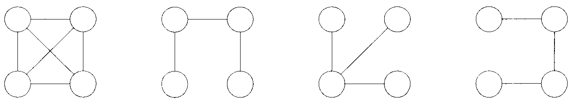
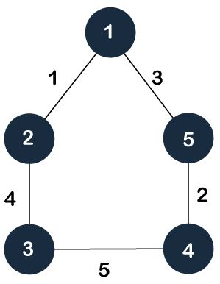
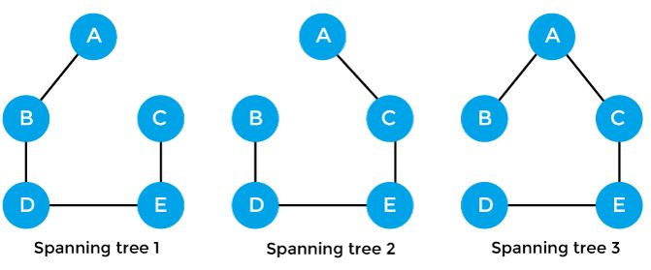
Example- Spanning Tree
For given graph, spanning trees created from the graph

Slide 39
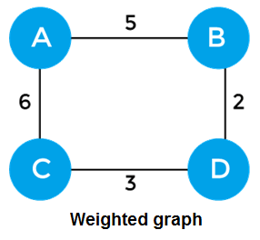
Minimum Spanning tree
A minimum spanning tree can be defined as the spanning tree in which the sum of the weights of the edge is minimum.
    If graph G is weighted and sum of weight/costs on its edges in spanning tree is minimum then it is called as Minimum spanning tree or Minimum-cost spanning tree.
The weight of the spanning tree is
sum of the weights given to edges
of the spanning tree.
The sum of edges of graph is 16.
Now, create possible spanning trees from graph which gives minimum cost

Slide 40
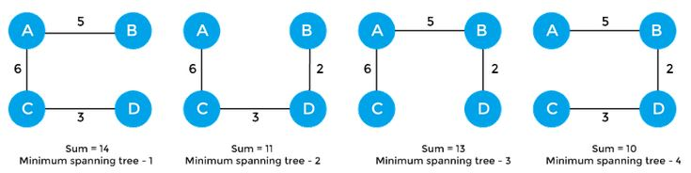
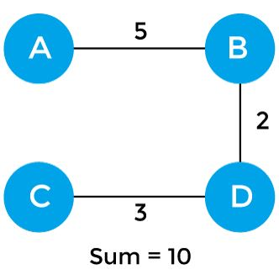
Minimum cost spanning tree
Possible spanning trees
Minimum cost spanning tree

Slide 41
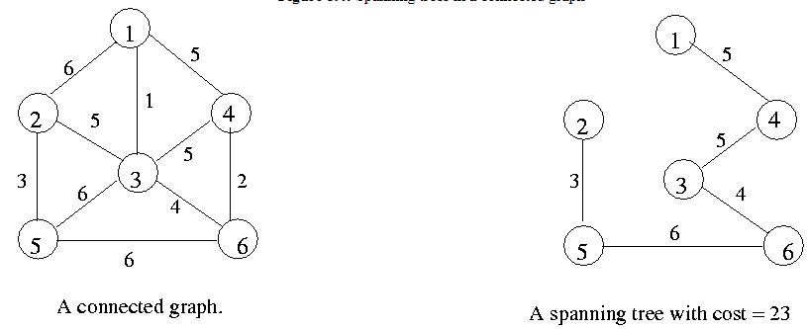
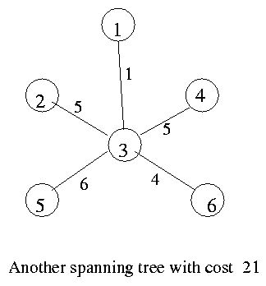
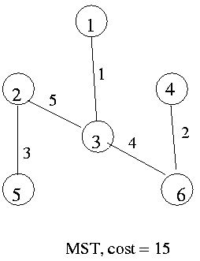
Minimum cost spanning tree

Slide 42
Algorithms for Minimum spanning tree
A minimum spanning tree can be found from a weighted graph using algorithms
  Prim's Algorithm
  Kruskal's Algorithm

Slide 43
Prim's algorithm
Prim’s algorithm is used to find minimum spanning tree from the graph.
Prim’s algorithm is also used to find minimum cost spanning tree.
Spanning tree –
  A spanning tree is the subgraph of an undirected connected graph.
Minimum Spanning tree –
  Minimum spanning tree is a spanning tree in which the sum of the weights of the edge is minimum.
  The weight of the spanning tree is the sum of the weights given to the edges of the spanning tree.
It starts with an empty spanning tree.
It follows greedy method, which finds an optimum solution at every stage

Slide 44
Prim's algorithm
It is used to find a minimum cost spanning tree for a weighted undirected graph by building tree edge by edge.
The next edge is chosen that results in minimum sum of costs of edges.
This algorithm finds the subset of edges that includes every vertex of the graph such that the sum of the weights of the edges can be minimized.
Prim's algorithm steps-
  Starts with any single node
  Explores all the adjacent nodes with all connecting edges at every step.
  Select the edges with minimal weights causing no cycles in graph.
  Add that edge to the tree.
  Repeat step above steps until the minimum spanning tree is formed.

Slide 45
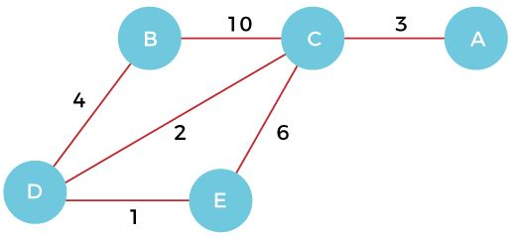
Example- Prim’s Algorithm
Consider a weighted graph
Find minimum spanning tree
Find cost of minimum spanning tree

Slide 46
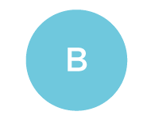
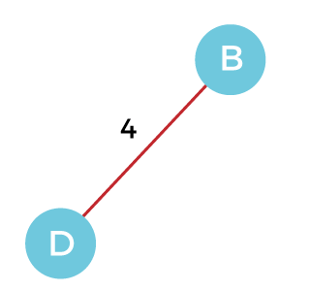
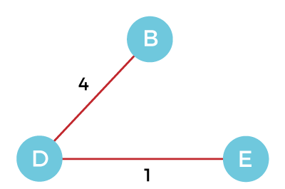
Step 1 - First, choose a vertex B from graph.
Step 2 – Find edges from node B.
  Two edges from vertex B are BC with
  weight 10 and edge BD with weight 4.
  Select minimum edge BD add it to the MST.
Step 3 – Now two edges DE and CD from vertex D.
  Select minimum edge DE and add it to the MST.

Slide 47
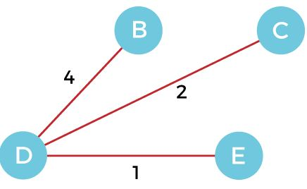
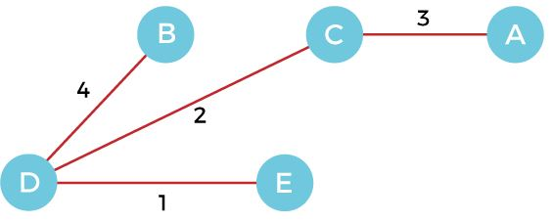
Step 4 - Now, select the edge CD as it is Step 5 - Now, choose the edge CA
minimum and add it to the MST. and add it to the MST.
Graph produced in step 5 is minimum spanning tree of the given graph.
The cost of MST is = 4 + 2 + 1 + 3 = 10 units.
Time taken by Prim’s Algorithm
  Number of vertices |V|
  Number of Edges |E|=|V|-1
  Time taken= O(|V|.|E|)= O(n . n)= O(n²)

Slide 48
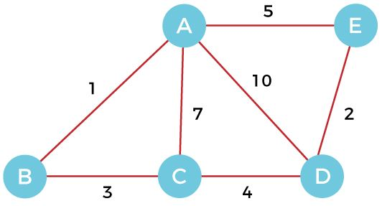
Example- Prim’s Algorithm
Consider a weighted graph
Find minimum spanning tree
Find cost of minimum spanning tree

Slide 49
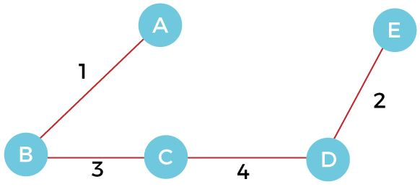
Example- Prim’s Algorithm
For a given weighted graph
Minimum spanning tree is
Cost of minimum spanning tree MST= 1+3+4+2= 10

Slide 50
Minimum cost spanning tree

Slide 51
Kruskal's algorithm
Kruskal's algorithm is used to find the minimum spanning tree for a connected weighted graph.
Kruskal's algorithm also follows greedy approach, which finds an optimum solution at every stage instead of focusing on a global optimum.
In Kruskal's algorithm, we start from edges with the lowest weight and keep adding the edges until minimum spanning tree is created.
The steps to implement Kruskal's algorithm-
  First, sort all the edges from low weight to high.
  Now, take the edge with the lowest weight and add it to the spanning tree. If the edge to be added creates a cycle, then reject the edge.
  Continue to add edges until we reach all vertices, and a minimum spanning tree is created.

Slide 52
Aapplications of Kruskal's algorithm
  Kruskal's algorithm can be used to layout electrical wiring among cities.
  It can be used to lay down LAN connections.
Example of Kruskal's algorithm
Consider a weighted graph and
Find minimum spanning tree
Find cost of minimum spanning tree.

Slide 53

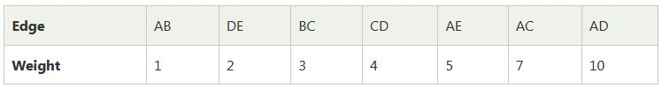
Given graph is
Consider a weight of the edges and add into table
Sort the edges given in table in the ascending order of their weights.

Slide 54
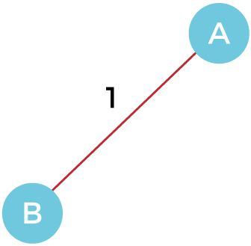
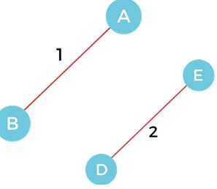
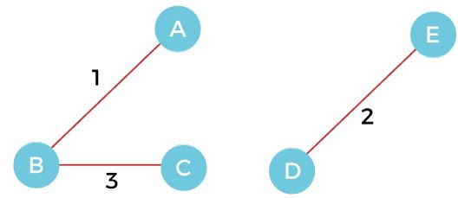
Now construct minimum spanning tree.
Step 1 - First, add the edge AB with weight 1 to the MST.
Step 2 - Add the edge DE with weight 2 to the MST as it is not creating the cycle.
Step 3 - Add the edge BC with weight 3 to the MST, as it is not creating any cycle or loop.

Slide 55
Step 4 - Now, add edge CD with weight 4
to the MST, as it is not forming the cycle.
Step 5 - After that, pick the edge AE with weight 5.
Including this edge will create the cycle, so discard it.
Step 6 - Pick the edge AC with weight 7.
Including this edge will create the cycle, so discard it.
Step 7 - Pick the edge AD with weight 10.
Including this edge will also create the cycle, so discard it.

Slide 56
Final minimum spanning tree obtained
from the given weighted graph
by using Kruskal's algorithm
The cost of the MST is = AB + DE + BC + CD = 1 + 2 + 3 + 4 = 10.
Number of edges in tree equals the number of vertices minus 1. So, the algorithm stops here.
Time taken by Kruskal’s Algorithm
  Number of vertices |V|
  Number of Edges |E|=|V|-1
  Time taken= O(E logE) or O(V logV)

Slide 57
Example- Kruskal’s Algorithm
Consider a weighted graph
Find minimum spanning tree
Find cost of minimum spanning tree

Slide 58
Minimum spanning tree of the given graph.
The cost of MST is = 4 + 2 + 1 + 3 = 10 units.

Slide 59
End of Unit

